Slide 1
CHAPTER 6
Cellular Respiration:
Obtaining Energy from Food
Notes:
Metabolism
-Anabolism small -> large
-Catabolism large -> small

Slide 2
  Aerobic metabolism
    Occurs when enough oxygen reaches cells to support energy needs.
    Maximum ATP created
  Anaerobic metabolism
    Occurs when the demand for oxygen outstrips the body’s ability to deliver it.
    Not as efficient as aerobic
Notes:
ATP + oxygen -> ADP + energy Aerobic Not a quick work out
ATP breaks 1 bond of to release high energy into ADP
*ATP – Adenosine tri-Phosphate

Slide 3

  Anaerobic metabolism
    Without enough oxygen, muscle cells break down glucose to produce lactic acid.
    But why do muscles burn?
      Assigned reading in Scientific American: Why does lactic acid build up in muscles? And why does it cause soreness?
Notes:
☹

Slide 4
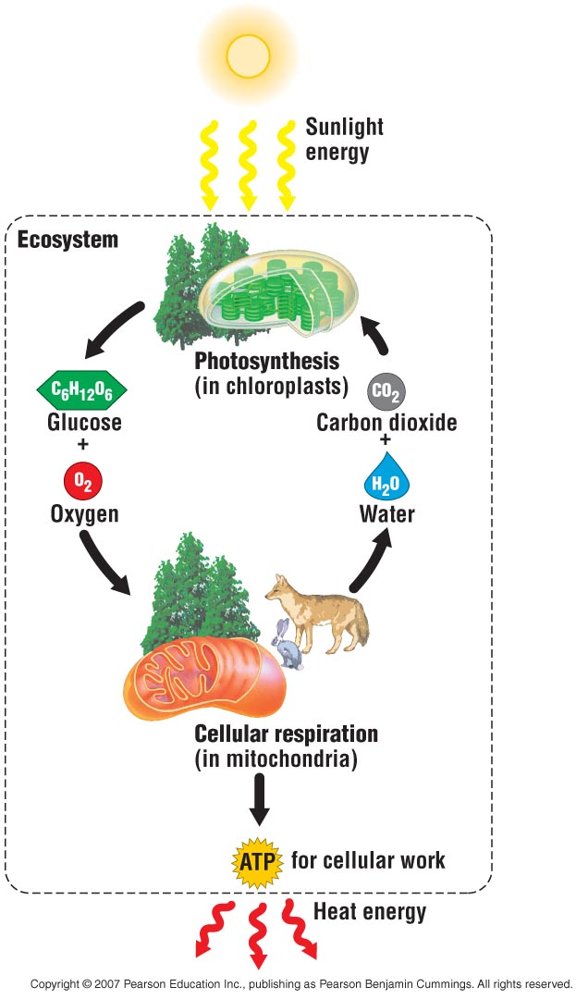
  Fuel molecules in food represent solar energy.
  Animals depend on plants to convert solar energy to chemical energy.
    This chemical energy is in the form of sugars and other organic molecules.

Slide 5
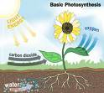
  Both plants and animals perform aerobic cellular respiration.
    Cellular respiration is a chemical process that harvests energy from organic molecules & converted to ATP
    Cellular respiration occurs in mitochondria.
  The waste products of animal cellular respiration, CO₂ and H₂O, are used in photosynthesis for plants.

Slide 6
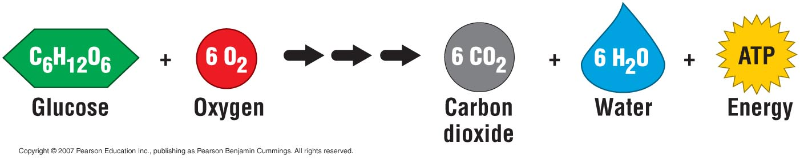
The Overall Equation for Cellular Respiration
  A common fuel molecule for cellular respiration is glucose.
    The overall equation for what happens to glucose during cellular respiration

Slide 7
Metabolic Pathway of Cellular Respiration
  Cellular respiration is an example of a metabolic pathway,
    A series of chemical reactions in cells.
  All of the reactions involved in cellular respiration can be grouped into three main stages:
    Glycolysis
    The citric acid cycle or the Krebs Cycle
    Electron transport or Oxidative Phosphorylation

Slide 8
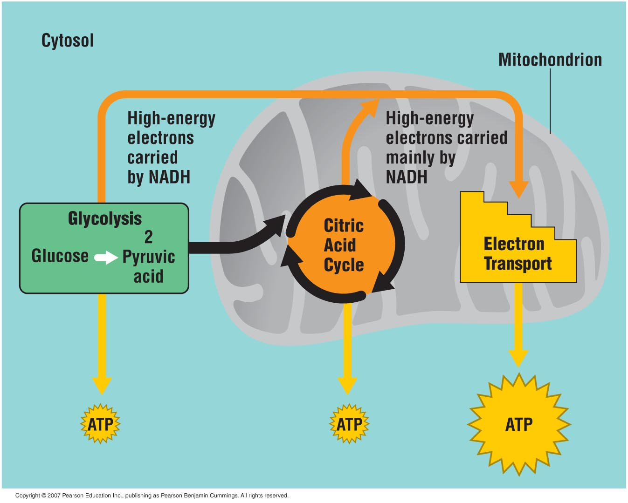
  The path of glucose through cellular respiration
Notes:
Electron carriers
*NAD – Nicotinamide Adenine Dinucleotide(oxidized) -> NADH(reduced)
*FAD – Flavin Adenine Dinucleotide
Redox Oxidation & Reduction
Only electron transport do Aerobic, other twos are anaerobic.

Slide 9
Stage 1: Glycolysis
A molecule of glucose (1, six carbon molecule) is split/brokendown into two molecules of pyruvic acid.
Glycolysis makes some ATP directly = 2 ATP from 1 Glucose Molecule
Can occur anaerobically

Slide 10


Fun Fact!
Ancient bacteria probably used glycolysis to make ATP long before oxygen was present in Earth’s atmosphere.
    Glycolysis is a metabolic heirloom from the earliest cells that continues to function today in the harvest of food energy.
    But is an inefficient way of making ATP

Slide 11
Stage 2: The Citric Acid Cycle, aka The Krebs Cycle
  The citric acid cycle completes the breakdown of sugar. (Glucose in our example)
  In the citric acid cycle, pyruvic acid from glycolysis is first “prepped” into a usable form, Acetyl CoA.
  2 ATP Created
Notes:
Pyruvic acid(丙酮酸)

Slide 12
Stage 3: Electron Transport, aka Oxidative Phosphorylation
  Electron transport releases the energy your cells need to make most of their ATP
  The molecules of electron transport chains are built into the inner membranes of mitochondria.
    functions as a chemical machine that uses energy released by the “fall” of electrons

Slide 13
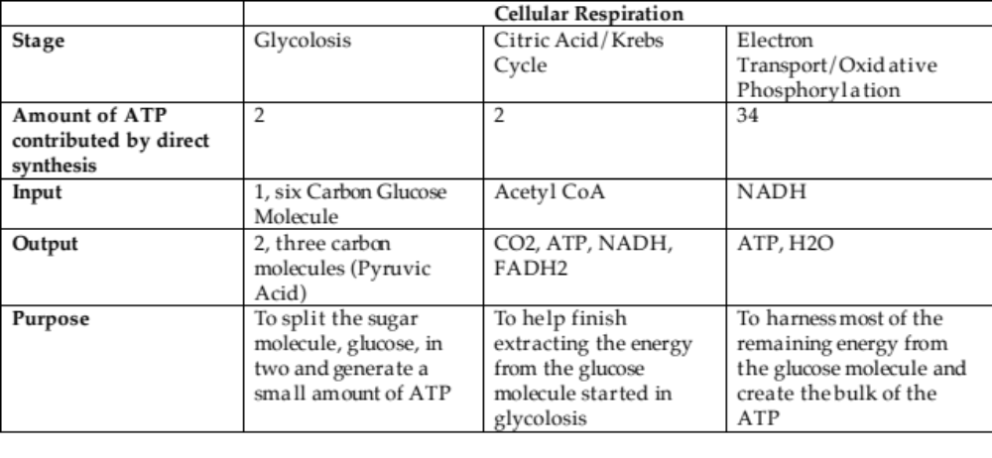
Let’s review with a concept map
Notes:
38 ATP per glucose molecule

Slide 14



The Versatility of Cellular Respiration
  Cellular respiration can “burn” other kinds of molecules besides glucose:
    Diverse types of carbohydrates
    Fats
    Proteins

Slide 15
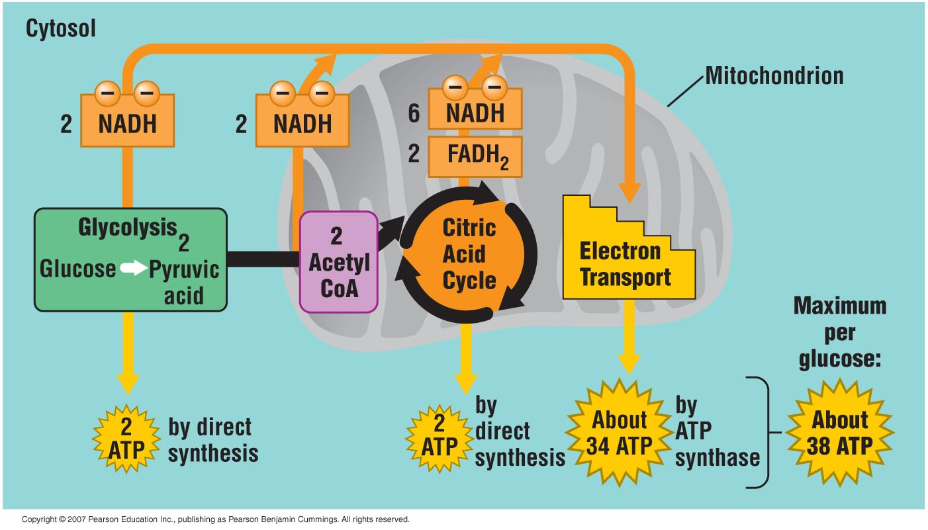
Adding Up the ATP from Cellular Respiration
Some books
say 36! Either is
Right.
Notes:
Important!

Slide 16
Fermentation: Anaerobic Harvest of Food Energy
  Some of your cells can actually work for short periods without oxygen.
  Fermentation
    Is the anaerobic harvest of food energy through Glycolysis
Notes:
Fermentation
- Yeast

Slide 17
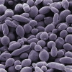
Fermentation in Microorganisms
  Various types of microorganisms perform fermentation.
    Yeast cells carry out a slightly different type of fermentation pathway.
    This pathway produces CO₂ and ethyl alcohol.
Notes:
Ethyl alchol – C2H5OH
Methyl Alchol CH3OH

Slide 18

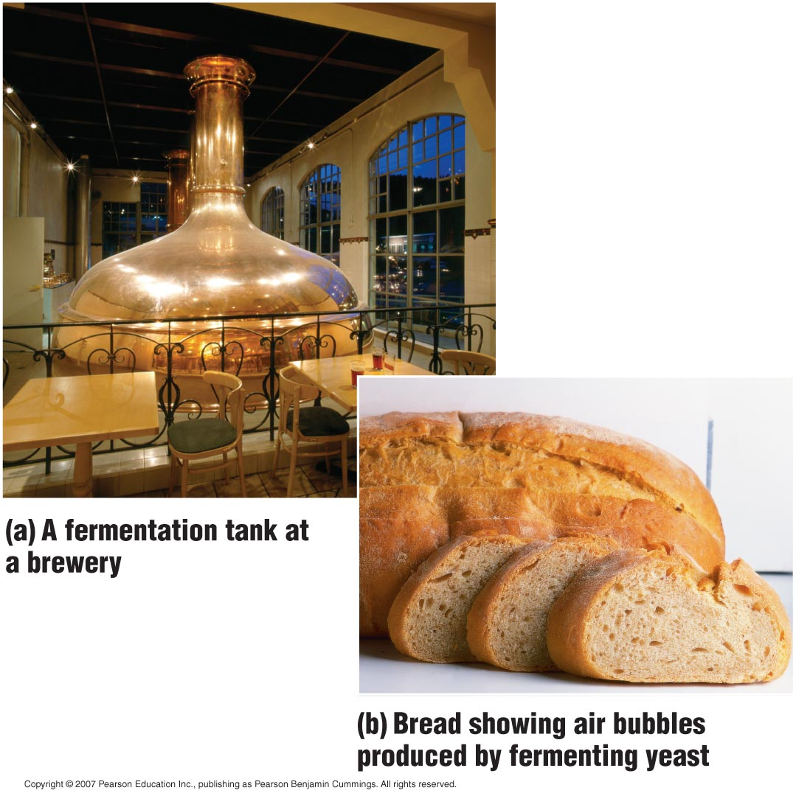
  The food industry uses yeast to produce various food products.

